Slide 1


Applied Cryptography
Ms. Swati Mali
B-215
swatimali@gmail.com
Assistant Professor, Department of Computer Engineering
K. J. Somaiya School of Engineering
Somaiya Vidyavihar University

Slide 2
Applied Cryptography and real world
The Enigma Machine & World War II
What: breaking Germany’s Enigma cipher shortened WWII by ~2 years and saved millions of lives.
Why: Demonstrates the life-or-death impact of cryptography.
Emphasis: Weak crypto = catastrophic consequences.

Slide 3
Applied Cryptography and real world
The Zimmerman Telegram (World War I)
What: A decrypted German diplomatic message that brought the US into WWI.
Why: Cryptanalysis changed the course of history.
Emphasis: Cryptography influences global politics.

Slide 4
Applied Cryptography and real world
Edward Snowden & NSA Surveillance Leaks (2013)
Story: Snowden revealed global surveillance programs exploiting encryption weaknesses.
Why: Exposed how government agencies break or bypass cryptography to gather intelligence.
Emphasis: Privacy vs. surveillance, trust in cryptographic systems.

Slide 5
Applied Cryptography and real world
The FBI vs. Apple Encryption Dispute (San Bernardino Case)
Story: FBI demanded Apple unlock an iPhone; Apple refused citing global security concerns.
Why: Raised ethical, technical, and legal debates on encryption backdoors.
Emphasis: Security vs. law enforcement access.

Slide 6
Applied Cryptography and real world
Stuxnet Malware (Cyber-Warfare)
Story: Cyberattack on Iran’s nuclear program using forged digital certificates and exploits.
Why: A sophisticated example of cryptography in cyber-warfare.
Emphasis: Cryptographic trust abused in malware delivery.

Slide 7
Applied Cryptography and real world
Gerard Cotten / QuadrigaCX Mystery
Story: Gerard Cotten, CEO of QuadrigaCX, Canada's largest crypto exchange, allegedly died in 2018. He was the only person with access to the private keys securing ~$190 million in cryptocurrency. No keys, no access — money gone.
Lesson:
  Importance of key management policies
  Cryptography isn’t enough without governance
Emphasis: Systems fail not just technically, but operationally.

Slide 8
Applied Cryptography and real world
KGB Deep Infiltration into the US (The Americans, Real Basis)
Story: Soviet spies (Illegals Program) embedded deep into American life, using covert communication techniques including one-time pads, dead drops, and coded messages.
Lesson:
  Cryptography is central to espionage (communications security)
  Weaknesses aren’t always technical — sometimes social.
Emphasis: Cryptography as an enabler of covert operations.

Slide 9
Applied Cryptography and real world
Gillette Trade Secret Theft During Razor Launch (Corporate Espionage)
Story: In 1997, an engineer leaked confidential designs for Gillette's upcoming razor to competitors. The breach was detected when emails were found, but the intent was to sell competitive advantage through stolen information.
Lesson:
  Protecting data at rest and in transit (encryption, DLP systems)
  Insider threats can bypass crypto if access controls fail.
Emphasis: Corporate security relies on cryptography and policies.

Slide 10
Applied Cryptography and real world
Pepsi vs Coca-Cola: Espionage Thwarted by Encryption
Story: In 2006, Coca-Cola employees tried to sell trade secrets (including new formula details) to Pepsi. Pepsi reported them to the FBI instead. Some of the leaked material included protected corporate information.
Lesson:
  Encryption in business is critical to protecting IP.
  Ethical responses to corporate espionage matter.
Emphasis: Corporate trust relies on protecting secrets cryptographically.

Slide 11
Applied Cryptography and real world
Corporate Espionage and Encryption
Examples:
  Volkswagen vs. GM: Alleged theft of car designs through insider leaks.
  Samsung vs. Apple: IP theft claims involving trade secrets.
  Modern espionage includes planting malware to extract encrypted files.
Lesson:
  Encryption prevents easy data leaks.
  Insider threats need cryptography plus controls (e.g., PKI, MFA, audit logs).
Emphasis: Real-world economic impact of weak cryptographic protection.

Slide 12
Lesson?
“Behind every major theft, betrayal, and billion-dollar mistake, you'll often find either broken cryptography or broken trust in cryptography. Both are your responsibility as future engineers.”

Slide 13
Why?
Cryptography & Security
Keeps your information safe
Helps keep your reputation clean
Gives you a competitive edge
Saves on support and development costs

Slide 14
Security violation Examples?
https://www.livemint.com/news/trends/upset-with-termination-indian-national-deletes-data-worth-rs-5-6-crore-from-singapore-company-server-11718439829899.html
https://www.csoonline.com/article/2130877/the-biggest-data-breaches-of-the-21st-century.html
https://www.ekransystem.com/en/blog/real-life-exam
https://firewalltimes.com/netflix-data-breach-timeline/
https://www.upguard.com/blog/biggest-data-breaches-us
https://www.wired.com/2012/08/apple-amazon-mat-honan-hacking/

Slide 15
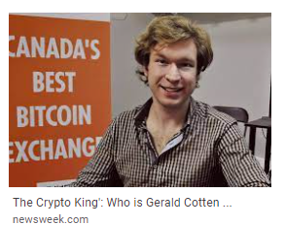
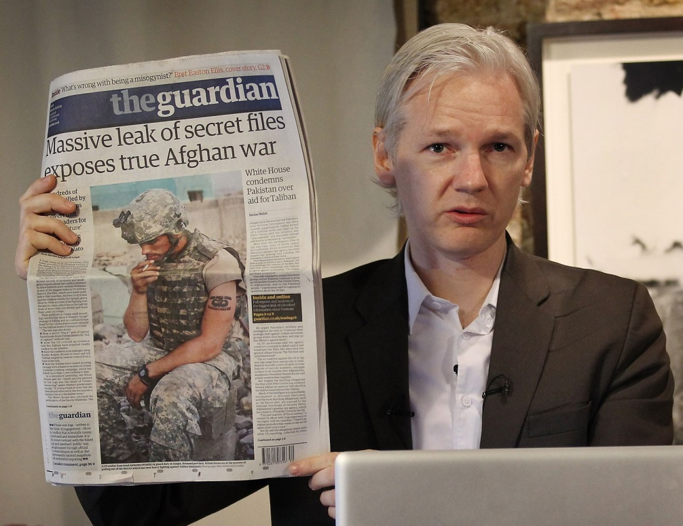
Popular story
GC pic source- newsweek.com
JA pic source- https://www.britannica.com/biography/Julian-Assange

Slide 16
Forms of security?
Data security
Programming security
Network security
OS security
Database security

Slide 17
Security at a glance
How can you make yourself secure?
How can you break other’s security?
Combination of both!!

Slide 18
How to make/break secure systems?

Slide 19
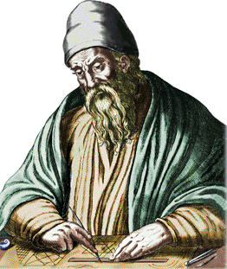
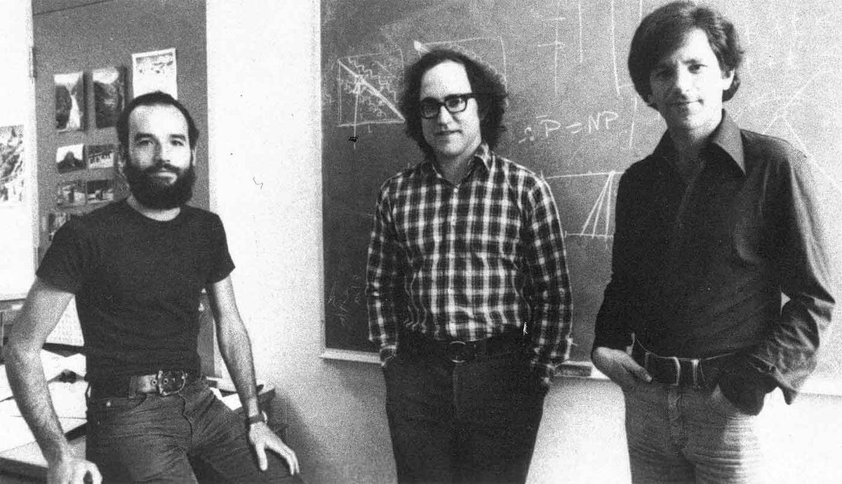
1. Mathematical concepts
Number Theory
Security Algorithms

Slide 20
How to make/break secure systems?
Programming carefully
Using various layers/forms of security
Obfuscation
Look for weaknesses and attack them

Slide 21
Syllabus

Slide 22
Lab work

Slide 23
Lab CA breakup
Lab experiments – 25 Marks
Lab CA components – 20 (10 marks each)
Theory and Lab attendance- 5 Marks

Slide 24
Internal assessments
IA1
  Cryptanalysis test- in classroom
  Group assignment
  Aug 19,2025
IA 1
  Protocol Design and authentication mechanism for secure data transmission
  Group assignment
  Open book, internet will be disconnected
  Post ISE, on Sept 23,2025
IA2
  Case study Analysis to discover cryptographic techniques used, vulnerabilities, MOMs, attacks. Suggest controls.
  Group assignment
  Open book, internet will be disconnected
  Nov 04,2025

Slide 25
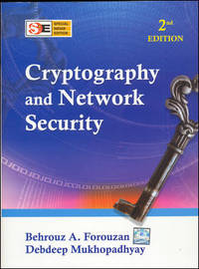
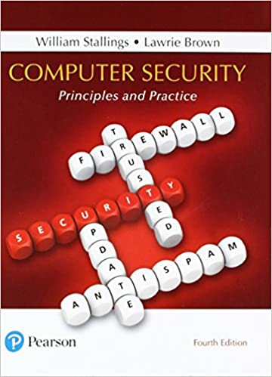
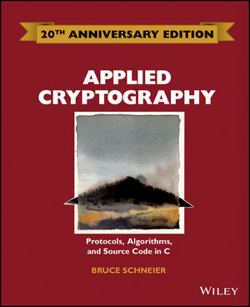
Books

Slide 26
Course Outcomes
CO1: Discuss fundamentals of cryptography and classical attacks on security goals
CO2: Implement various Cryptographic arithmetic algorithms for securing systems
CO3: Analyze and Implement Symmetric and ASymmetric Key Cryptography Algorithms
CO4: Understand Authentication Mechanisms and Evaluate Cryptographic Hash Functions
CO5: Explore and investigate advances in the field of cryptography

Slide 27
Questions?

